Slide 1
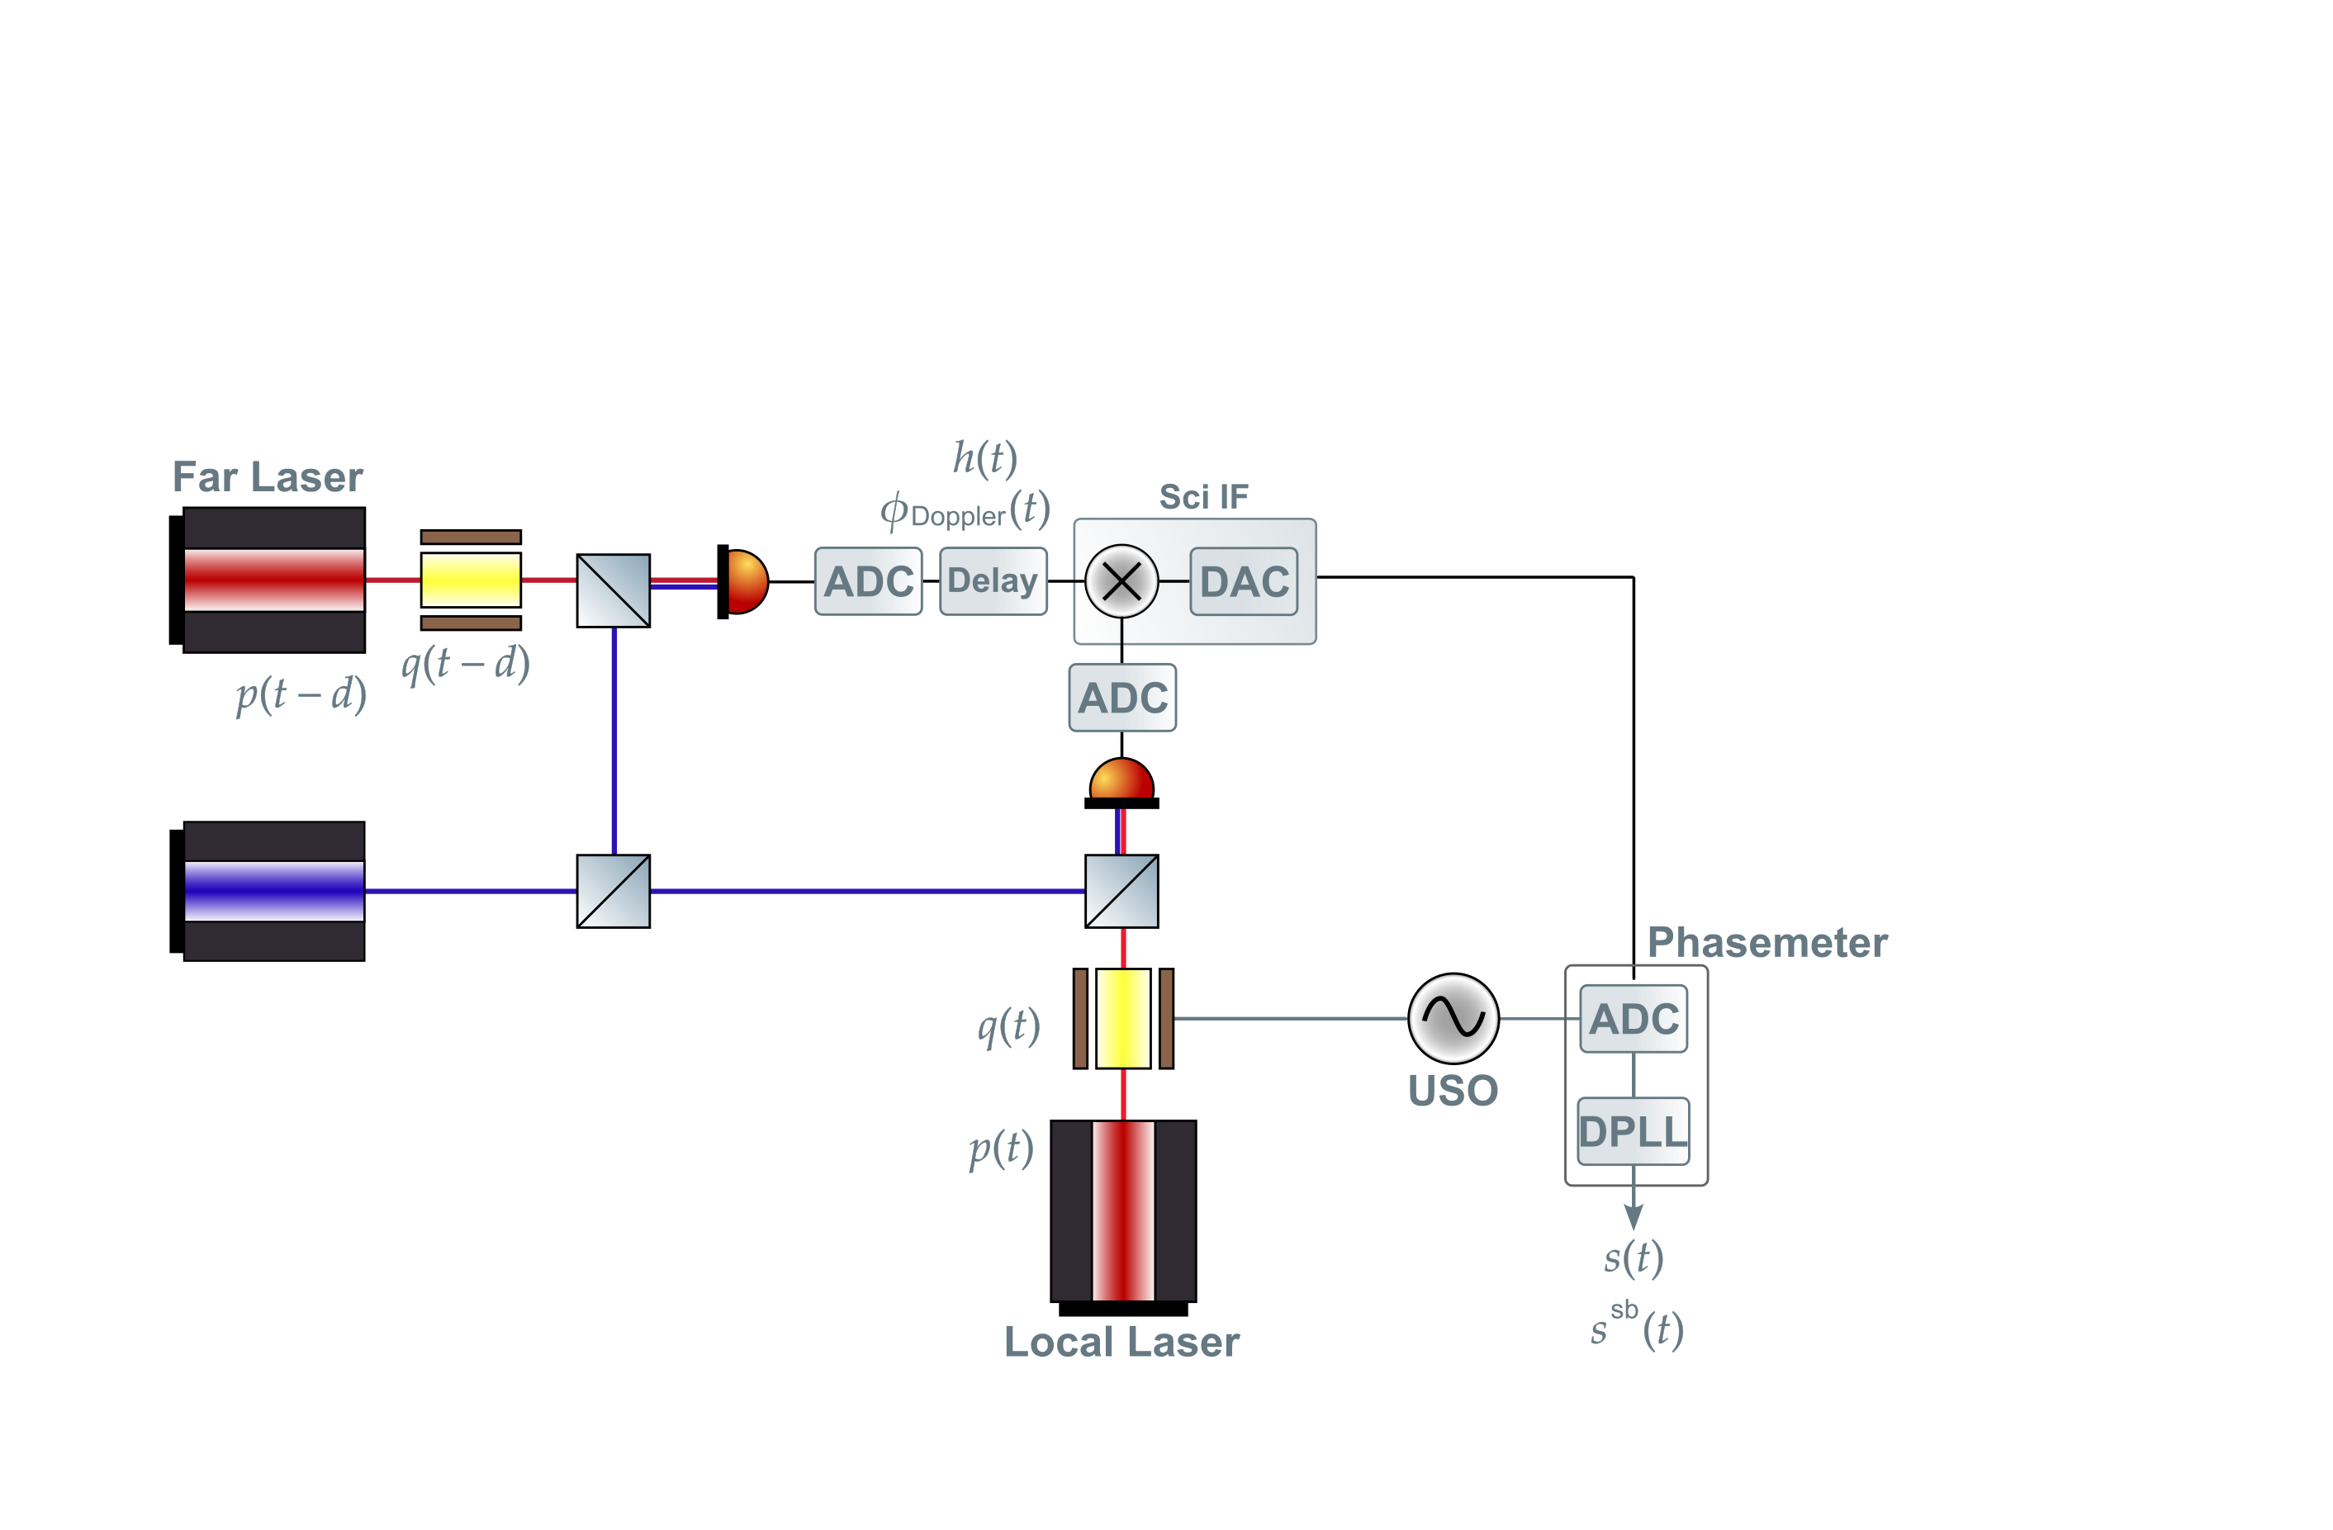
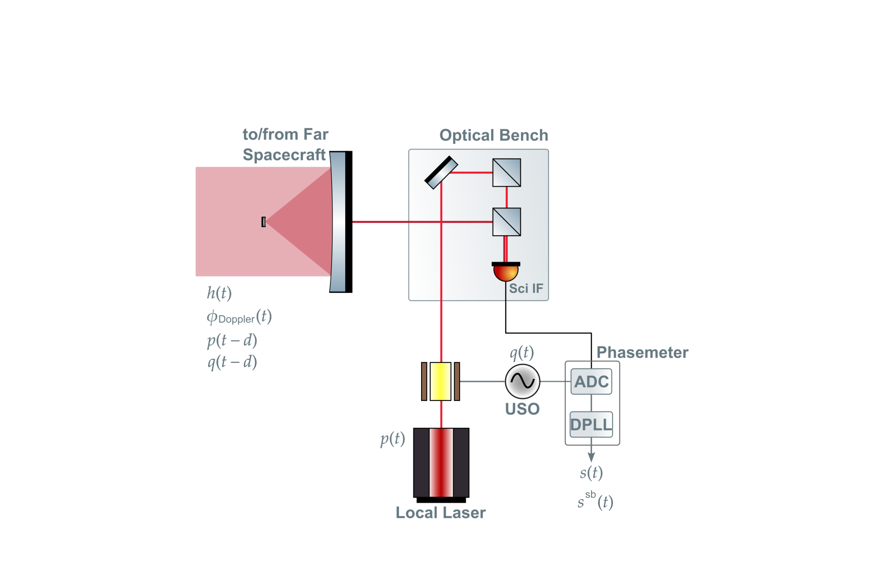
Arm Comparison

Slide 2
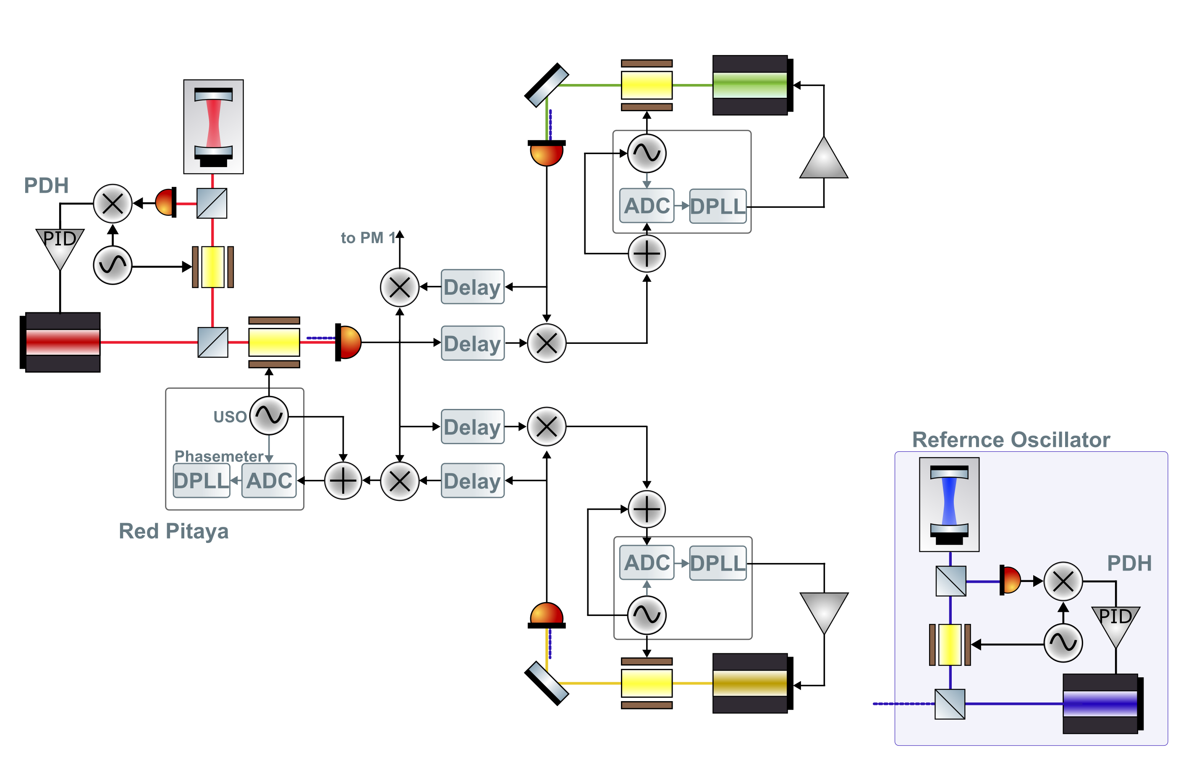
Full Thing?
Backlink noise = 0
Laser frequency offset for two lasers on one SC = 0
And their noise is the same
No optical bench noise
No acceleration noise

Slide 3
Full Thing?
2 channels per board
Noisy ADC

